Slide 1
Analysis of Weather Data and Opinion on Climate Change
TEAM MEMBERS:
Bharat Khandelwal
Mike Sanders
Satya Phanindra Kumar Kalaga
Will Kimball

Slide 2
Background
Climate change impacts us all.
However, some individuals have trouble believing that climate change is occurring.
This may be because people experience weather changes more frequently than climate change.
The Climate Change in the American Mind: National survey data on public opinion (2008-2022) attempts to determine the factors related to failing to believe climate change is happening.
The survey does not include data on individual’s weather experience.

Slide 3
SMART Questions
1) How have global temperature changes impacted US opinion of the existence of climate change since 2008?
2) How has temperature and rainfall impacted the perception of climate change occurring in individuals in the US since 2008?
3) How has the El Nino/La Nina weather pattern impacted public perception of climate change since 2008?
4) How have local weather patterns impacted the perceptions of climate change among different demographic groups since 2008?
5) How has extreme weather impacted public perception of climate change since 2008?

Slide 4
Our Dataset
Primary Source: Yale Program on Climate Change Communication (YPCCC) & George Mason University Center for Climate Change Communication (Mason 4C). (2020). Climate Change in the American Mind: National survey data on public opinion (2008-2022) [Data file and codebook]. doi: 10.17605/OSF.IO/JW79P
Secondary Sources: NOAA Now Data, OpenFEMA, NOAA Climate Prediction Center, NASA Climate

Slide 5
Understanding the Dataset
28 columns | Years 2008-2022
31,136 rows | 9 regions/cities
10 categorical variables | 4 data sources
YPCCC
NOAA
FEMA
NASA
Independent
Location
Demographic
City Weather
El Nino Pattern
Disaster/storm
Global Temp

Slide 6
Cleaning the Dataset
YPCCC
Selected key variables
NOAA
Weather data hand coded (copy paste from websites)
Rolled up to year
FEMA
data rolled up to region and year
N/A coded to 0
NASA
Merged by year

Slide 7
Cleaning the Dataset
For most columns, there was virtually no missing data
Marriage and Employment Status had some missing
Income had one row erroneously coded

Slide 8
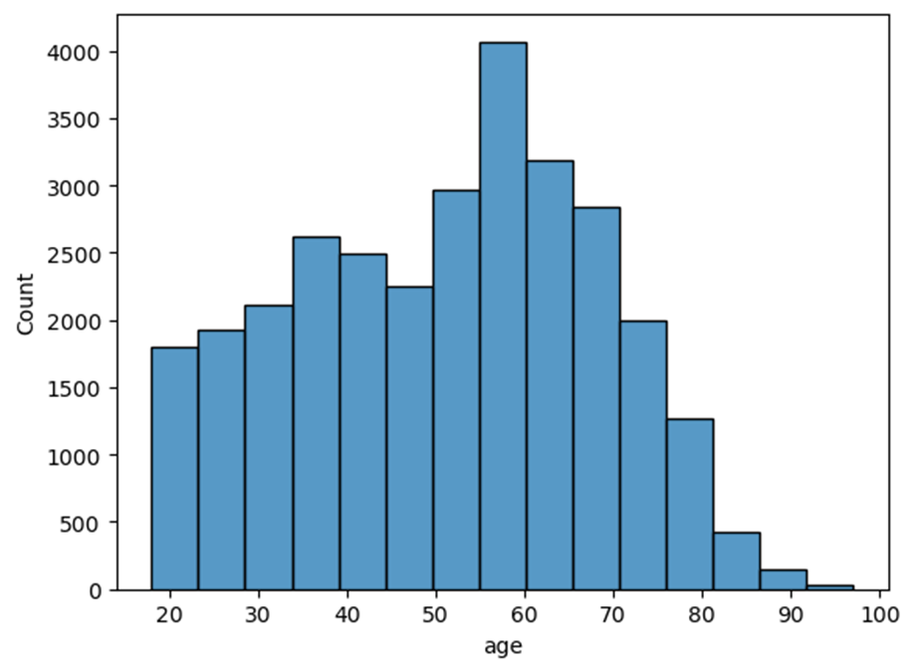
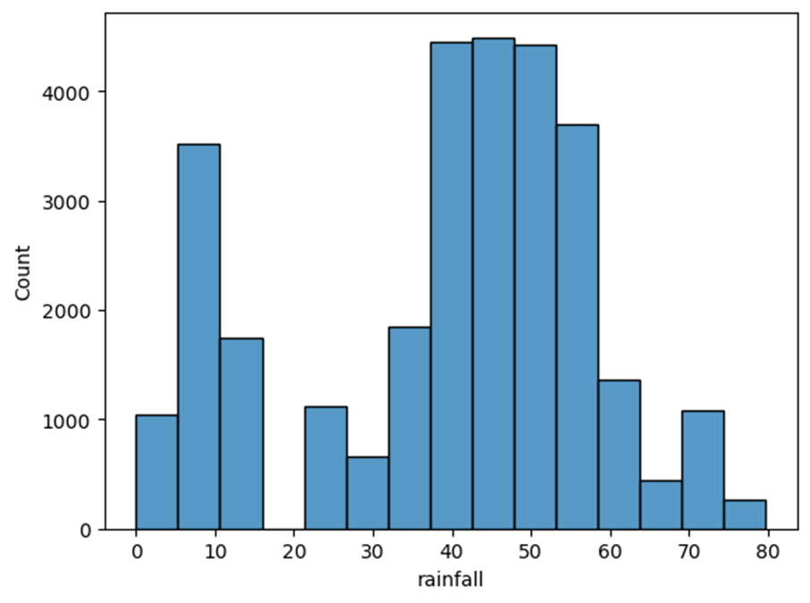
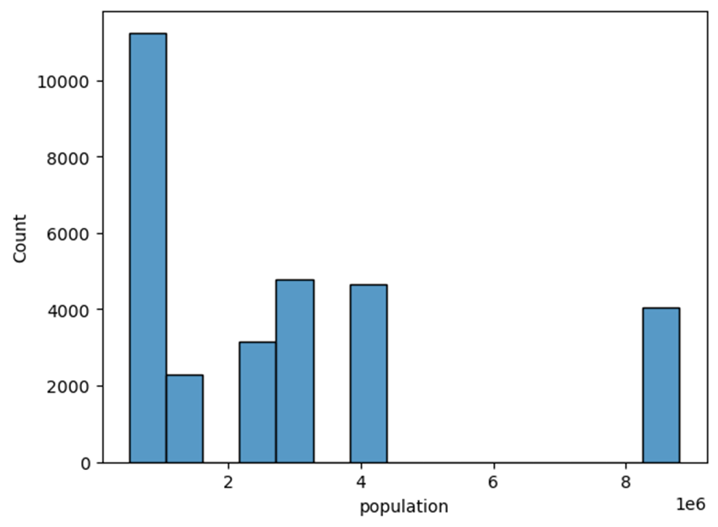
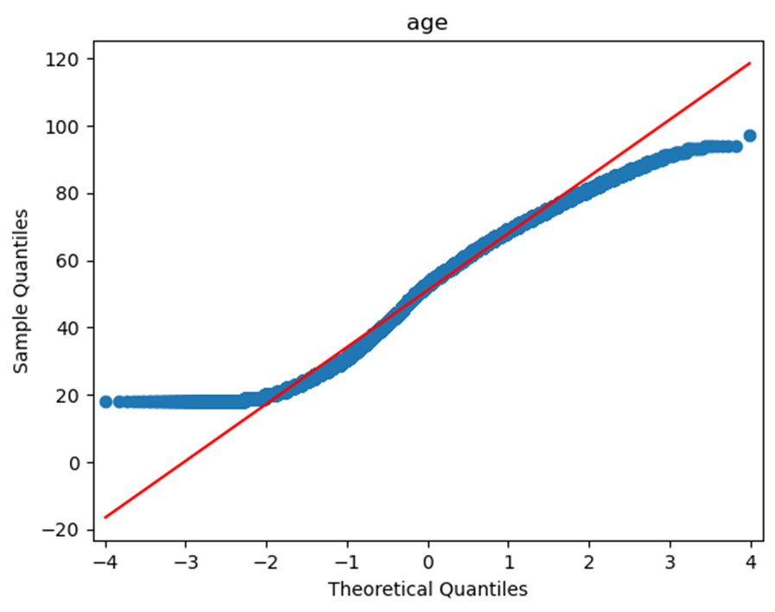
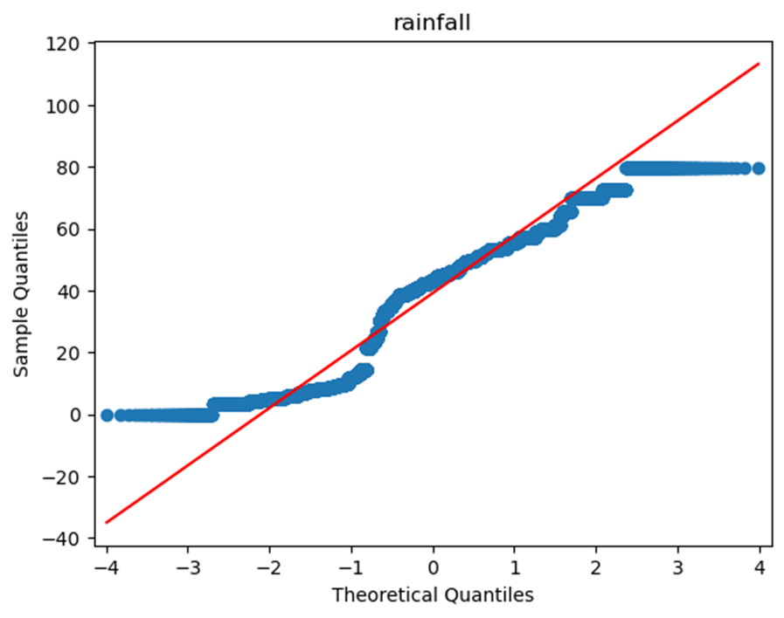
EDA - Visualizations
Varying levels of normality in our continuous variables

Slide 9
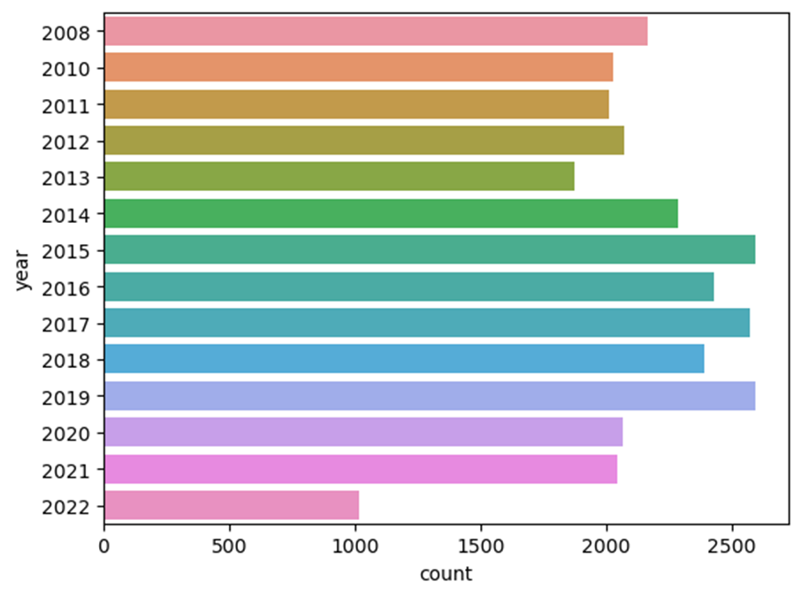
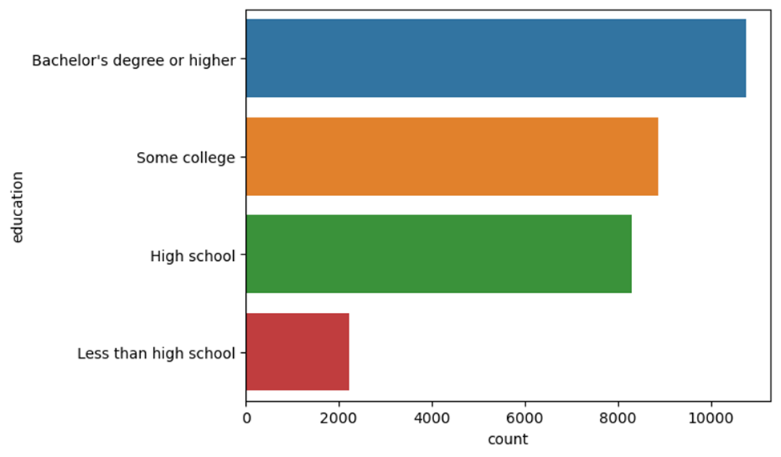
EDA - Visualizations (cont.)
Some categories were more uniformly distributed than others

Slide 10
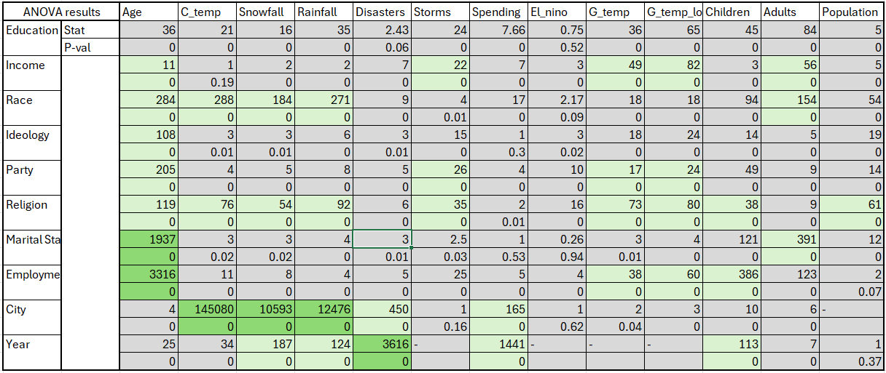
EDA - Statistical Tests (colored by effect size)
Many results significant, however only a few had notable effect sizes, light green shaded for Cohen’s f² > 0.02, dark green shaded for Cohen’s f² > 0.5

Slide 11
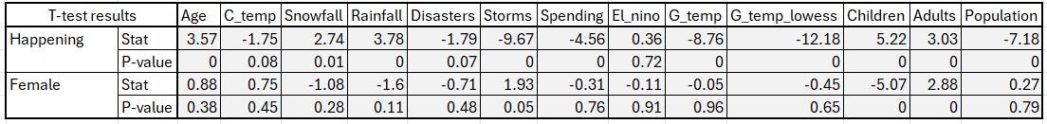
EDA - Statistical tests (cont., colored by effect size)
Our t-tests had some significance, but effect sizes of nearly 0. No Cohen’s d score above 0.2, so all have been shaded gray

Slide 12
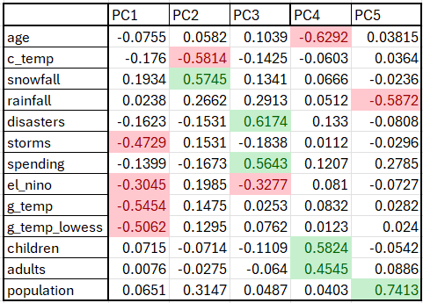
EDA - PCA
Results from PCA were largely expected
Cutoff for shading was +/- 0.3

Slide 13
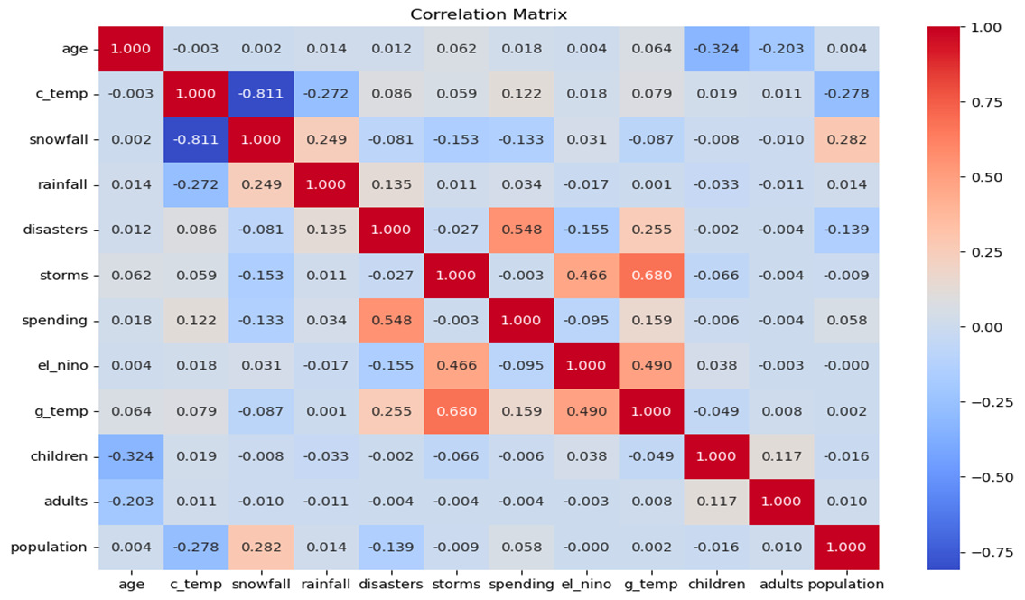
Correlation Matrix
As observed the correlation matrix gives us how the variables are related.
For example after disasters people have to spend so spending and disasters have a moderately strong positive correlation.

Slide 14
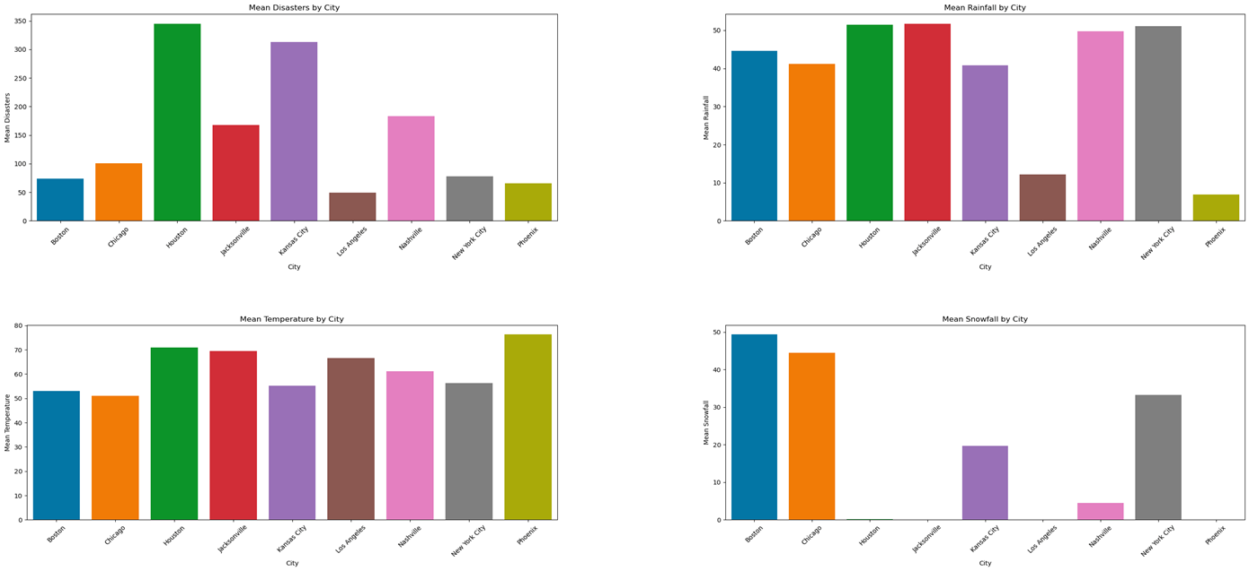
The above plots give distribution of Disasters, rainfall,temperature and snowfall.

Slide 15
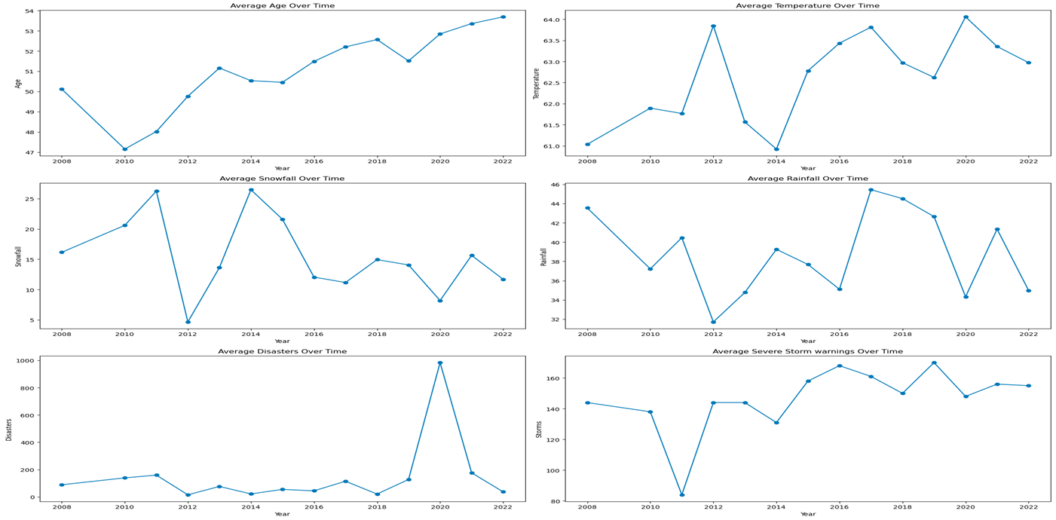
EDA – Visualization (line Plots for trends)

Slide 16
Trend Analysis
Age: The average age of the population seems to be increasing steadily over the years after a sharp fall in the year 2010.
Average Temperature : There is a clear upward trend in average temperatures over time with a sharp fall in 2014, indicating a potential long-term increase in temperature.
Snowfall: The average snowfall shows a decreasing trend over the years, suggesting a possible decrease in snowfall amounts over time.
Rainfall: The average rainfall appears to decrease initially and then stabilize at a lower level with increase in the year 2017, indicating a potential change in rainfall patterns over time.
Natural Disasters: The average number of natural disasters shows a steady trend with a a steep rise in the 2020.
Severe Storm warnings: The average number of severe storm warnings shows an increasing trend, indicating a potential increase in the frequency of these events over time.

Slide 17
Modeling
With the available clean data we built a base Logistic Regression model that would examine how weather patterns have impacted the perception of climate change across the US.
The output variable is boolean
Base model:
Happening = intercept + female +age + education levels + income under $50k + white + conservative + party + christian + year + location

Slide 18
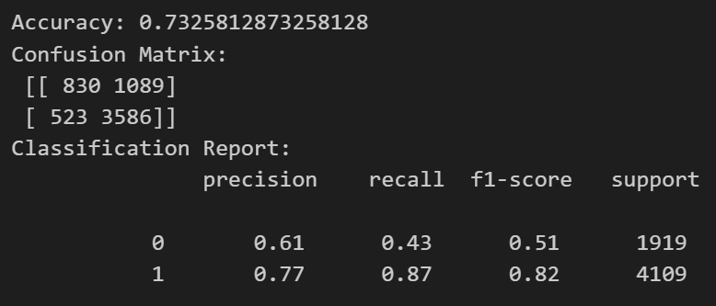
Base Model Output

Slide 19
Modeling cont.
1) Base model + g_temp
2) base model + rainfall + c_temp
3) base model + el nino
4) base model + rainfall + c_temp + el+nino
5) base model + storms + disasters + spending

Slide 20
Conclusions
1) How have global temperature changes impacted US opinion of the existence of climate change since 2008?
Global temperature rise wasn’t a significant predictor on it’s own.
2) How has temperature and rainfall impacted the perception of climate change occurring in individuals in the US since 2008?
Both Local temperature and rainfall are NOT significantly related to the opinion that “climate change happening”

Slide 21
Conclusions cont.
3) How has the El Nino/La Nina weather pattern impacted public perception of climate change since 2008?
El Nino/La Nina is significantly negatively related to the opinion of “climate change happening”
4) How have local weather patterns impacted the perceptions of climate change among different demographic groups since 2008?
With local weather temperature (positively correlated), El Nino is negatively correlated with opinions of climate change.
5) How has extreme weather impacted public perception of climate change since 2008?
Severe weather storms are positively related to the opinion that climate change is happening.

Slide 22
Discussion
Our model(s) did relatively well but had room for improvement
Opinions of climate change are likely to have little to do with actual weather.
Predict “not happening” with more focus on political and ideology?
“Happening” didn’t increase much over the time of this data set
May need more data to draw stronger conclusions
Survey sample may be biased

